Slide 1
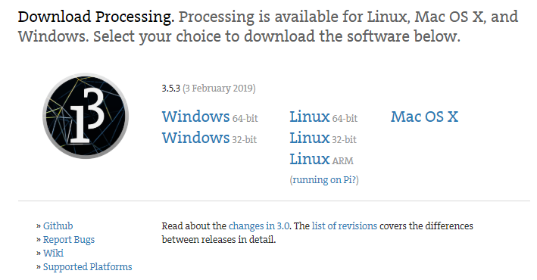
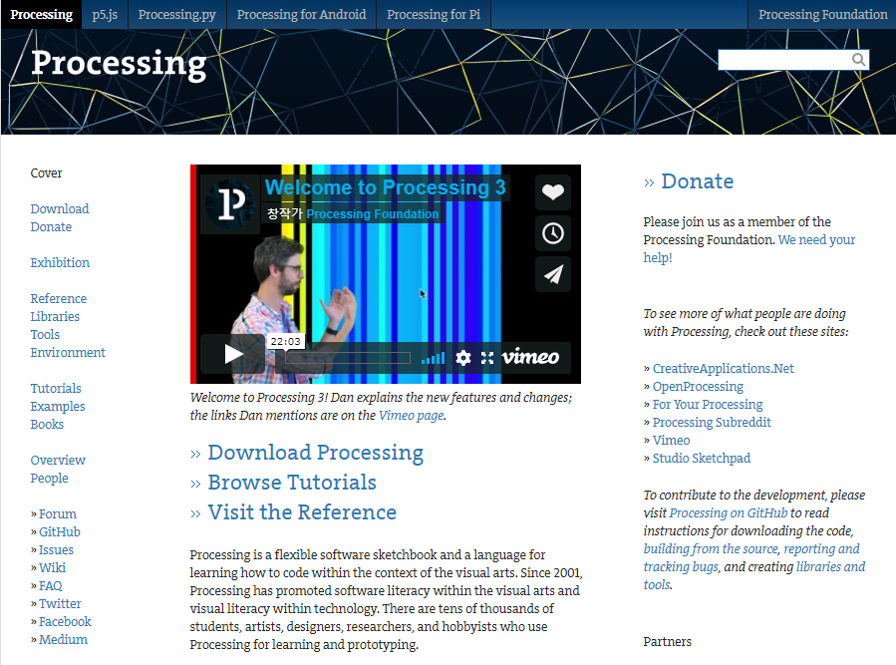
Go here https://processing.org/ -> Click “Download Processing” -> Click “Windows 64-bit”

Slide 2
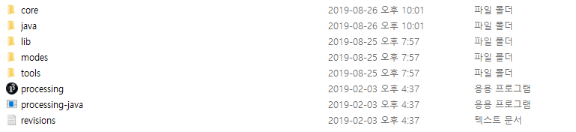
Open the “processing” program

